Slide 1
Discipline System in HCI
(College Section)

Slide 2
What is a HCI education?
A holistic education based on character and values:
Passion 积极乐学
Integrity 正直诚信
Innovation 善思创新
Empathy 仁爱仁心
Responsibility 尽力尽责
Notes:
Hwa Chong emphasizes not only academic excellence, but also a holistic education based on character education and values inculcation. These school values are embedded in the holistic education provided by HCI. A Hwa Chong student is expected to uphold the highest standard in their character and behaviour at all times, hence most important values are INTEGRITY AND RESPONSIBIITY. The school rules are in place to develop aspects of accountability and personal responsibility in you and towards other people. You are responsible for their own actions and you can earn demerit points for poor behaviour.

Slide 3


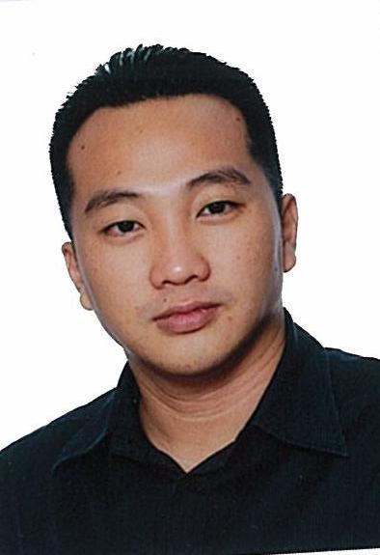
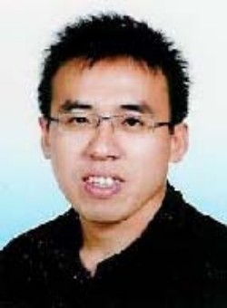
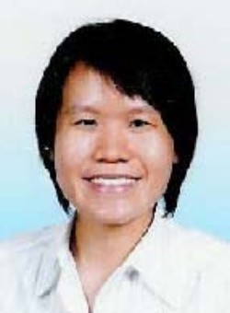





Discipline Committee 2015
Dr Hon
Mr Chan
Mr Ken Yeow
Mr Teh
Ms Wong
Mrs June Ng
Mr Khairulzad
Mrs Joiln Lim-Kong
Ms Grace Chua
Mr Teo Ming Ern

Slide 4
Rules and Regulation
(Hair, Uniform and Footwear)
Hair
Every student must maintain a neat & appropriate hairstyle at all times.
For boys,
Hair must not reach the ears or shirt collars
Fringes should not be floppy
Face must be clean-shaven
Avoid unusual hairstyles that attract others’ attention
For girls,
Long hair must be tied up neatly
Avoid unusual hairstyles that attract others’ attention
Prohibitions
Tinting, dyeing or highlighting of hair
Growing of moustaches & beards
Hairstyles that are deemed inappropriate by the School

Slide 5
Rules and Regulation
(Hair, Uniform and Footwear)
Uniform
For boys,
No skinny pants.
Length of pants must be appropriate .
Shirt must be properly tucked in at all times.
For girls,
No short skirt. (End of skirt -> Max 4 fingers higher than knees)
Skirt should not be worn too high up on the waist (making the body look short!)
Collar Pin
Must be put on when wearing the HCI uniform.

Slide 6
Rules and Regulation
(Hair, uniform and shoes)
Jewellery
Girls are allowed to wear a pair of simple and identical earrings.
The following are not allowed in school:
Flashy or chunky jewellery (rings, earrings, bracelets) or other accessories such as leather neckbands, bead chokers etc.
Earrings & ear-studs are not allowed for boys.
Multiple earrings or ear-studs are not allowed for girls.
Nail Polish
Not allowed in school.

Slide 7
Rules and Regulation
(Hair, uniform and shoes)
Footwear
All students are allowed to wear sports shoes are predominantly black or white without neon- or fluorescent-coloured panels/stripes. White socks should be visible at all times. Coloured socks are not allowed. Sandals may be worn only when a student is suffering from a foot/ankle injury. (Please refer to slides on Guidelines of Footwear in HCI)
Prohibitions
Moccasins and slippers
Liner & ankle socks that are not clearly visible when worn with shoes.

Slide 8
Discipline System in HCI
(College Section)
Minor Offences
No. | Types of Minor Offences | No. of Demerit Point(s)
1. | Late For School | 1
2. | Fail Spot-Check | 1
3. | Absent From Lesson/ Briefing/ Morning Assembly Without Valid Reason | 2
4. | Others (e.g. playing cards in school) | To be decided by Discipline Committee

Slide 9
Discipline System in HCI
(College Section)
Major Offences
No. | Types of Serious Offences | No. of Demerit Point(s)
1. | Defiance / Disrespectful | At least 2
2. | Truancy | 4
3. | Fighting | At least 4
4. | Vandalism | 10
5. | Cheating / Forgery / Plagiarism | 10
6. | Others (Cyber Offences, inappropriate behavior, act of dishonesty, etc..) | To be decided by Discipline Committee

Slide 10
Discipline System in HCI
(College Section)
Conduct Grade (Term)
Conduct Grade (End of Term) | No. Demerit Points
EXCELLENT | 0-1
VERY GOOD | 2
GOOD | 3-4
FAIR | 5 or more

Slide 11
Discipline System in HCI
(College Section)
Conduct Grade (Year)
Conduct Grade (End of Term) | No. Demerit Points
EXCELLENT | 0-4
VERY GOOD | 5-8
GOOD | 9-14
FAIR | 15 or more

Slide 12
Discipline System in HCI
(College Section)
Conduct Grade
A conduct grade will be given at the end of each school term.
A conduct grade will be indicated in all Block Tests, Promotional Examination and Preliminary Examination transcripts.
Students who do not show improvement in their conduct after attaining a “FAIR” conduct grade will be liable for further punishment at the discretion of the Discipline Committee.

Slide 13
Discipline System in HCI
(College Section)
Conduct Grade
Demerit Points are cumulative for each school term and will be reset to zero at the start of a new school term.
An email notification will be sent to both form teacher and student when an offence is committed.
A “Letter Of Warning” will be issued to students who has accumulated 9-14 demerit points for an academic year.

Slide 14
Discipline System in HCI
(College Section)
Letter Of Warning
A “Letter Of Warning” will be issued to students who has accumulated 9-14 demerit points for an academic year.
Parents / Guardians acknowledgement of the letter is required.

Slide 15
Discipline System in HCI
(College Section)
Letter Of Warning
Probation
- Accumulated 15 or more demerit points
in an academic year.
- Discipline records released to scholarship
organisations or universities upon
request.

Slide 16
Discipline System in HCI
(College Section)
Letter Of Advise For Punctuality
A “Letter Of Advise for Punctuality” will be issued to students who has accumulated 3 or more late coming offences in an academic term.

Slide 17
Discipline System in HCI
(College Section)
Hwa Chong Diploma
To be awarded the HC Diploma, a student must obtain “EXCELLENT” conduct grade for both academic years.

Slide 18
Discipline System in HCI
(College Section)
OCP – Out Of Campus Pass
Available at College Reception.
Have to be signed and shown to the security officers if you are leaving school before 1pm.
To be followed up by excuse documentations.

Slide 19
Discipline System in HCI
(College Section)
Available in the SMB
- Today’s Slides

Slide 20
Announcements
Uniform Sales
3/2 (Tue) and 4/2 (Wed)
Outside College Bookshop
9am-2pm
Boys - Shirt $12, Pants $16
Gorls – Blouse $11, Skirt $12

Slide 21

Notes:
You are responsible for their own actions and you can earn demerit points for poor behaviour.
Accumulated demerit points can affect final grades and eligibility for certain opportunities and awards such as OCIP, Hwa Chong Diploma, scholarships

